Slide 1

Edge AI – Principles and Practices
Module – Edge AI in the real world
By
Ning Chen, Ph.D.
Professor
Department of Computer
Science
California State University,
Fullerton
© Ning Chen, 2024
*

Slide 2
Module Objectives
This module explores some Edge AI applications in the real world and their design considerations.

Slide 3
Common use cases
Why Edge AI?
  50% of the Earth’s land is relatively untouched by human development.
  It is impractical/too costly to provide reliable/constant power in those areas.
  Data is huge in modern applications.
  Sending huge data for remote processing is not the best solution (or too expensive)
  Local processing is the choice (Edge AI)

Slide 4
Greenfield projects
Project site/condition/environment/infrastructure is new/untouched/primitive/uncultivated.
Pros: a blank sheet, freedom to choose latest/new technologies
Cons: risky (may not be successful), costly

Slide 5
Brownfield projects
Project site/condition/environment/infrastructure exists.
Pros: less expensive, lower risk, faster development
Cons: constraints

Slide 6
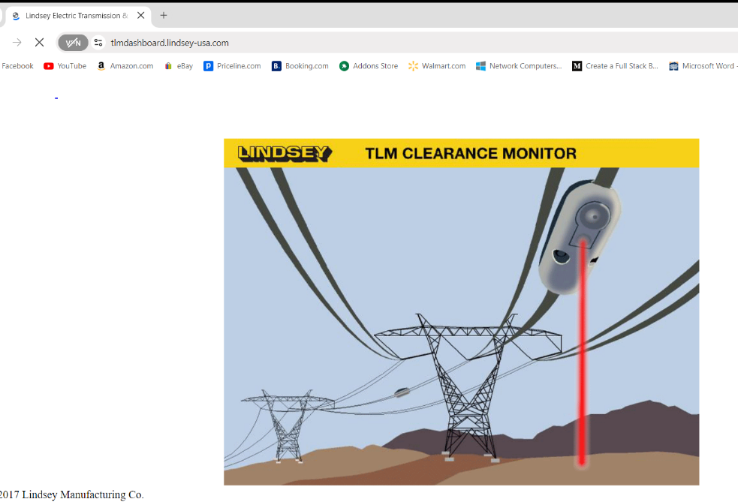
Real-world products
Power line monitoring
  Design experience (from the class instructor)

Slide 7
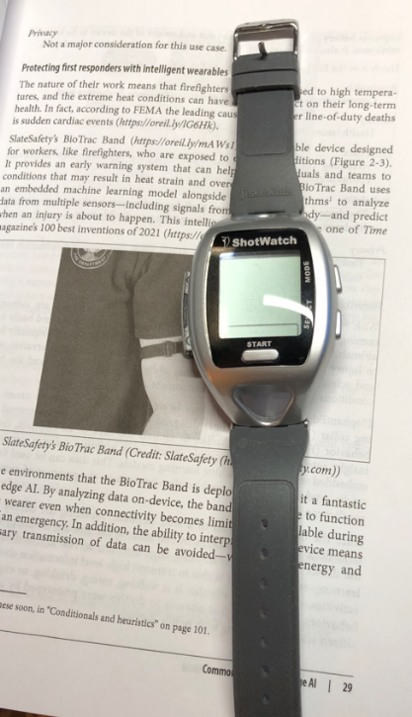
Real-world products
Wearable
  Design experience (from the class instructor)

Slide 8
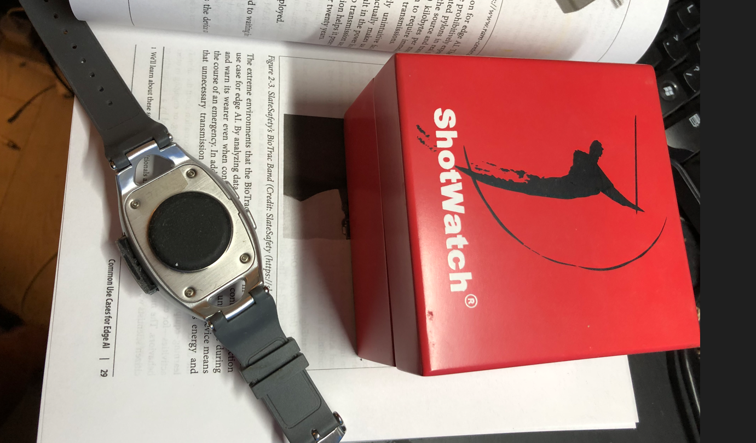
Real-world products
Wearable
  Design experience (from the class instructor)

Slide 9
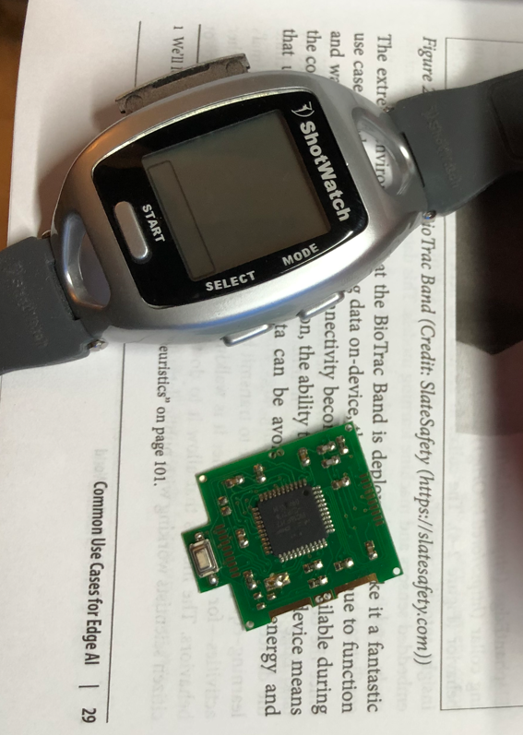
Real-world products
Wearable
  Design experience (from the class instructor)

Slide 10
Responsible design and AI ethics
AI has great impact on humanity.
Therefore, AI Ethics is an import topic.

Slide 11
Responsible design and AI ethics
Bias
  Favor some and prejudice others
Discrimination
  Treat individuals or groups differently
Fairness
  Hard to define (what is fair?)
  Fairness (equity, equality, inclusiveness)

Slide 12
Closing Thoughts
Lots of real-world applications
  Lots of business opportunities
How do you prepare yourself?
  Don’t stock up too many technologies
  Do have a “silo project” in which you executed tasks from the top to the bottom.
Ethics – Have a professional bottom line (don’t cross it)

